Slide 2
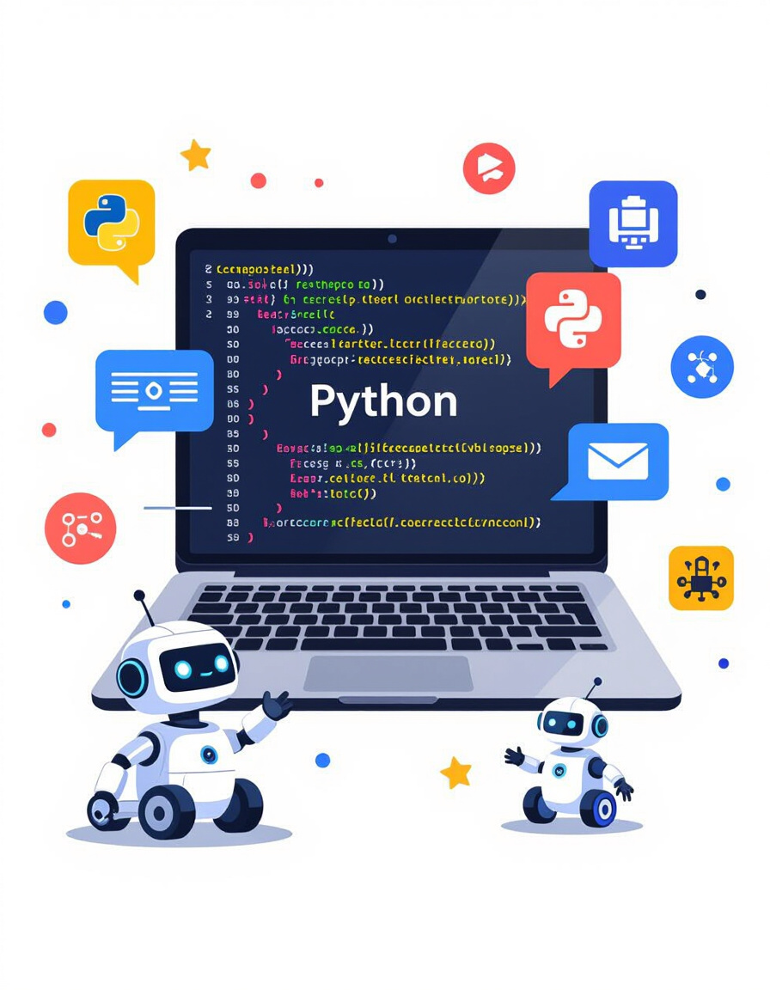
Introduction to Python
Python is a high-level programming language known for its simplicity and read- ability.
Makes it accessible for learners of all backgrounds.
Great for quickly prototyping ideas and building applications.

Slide 3
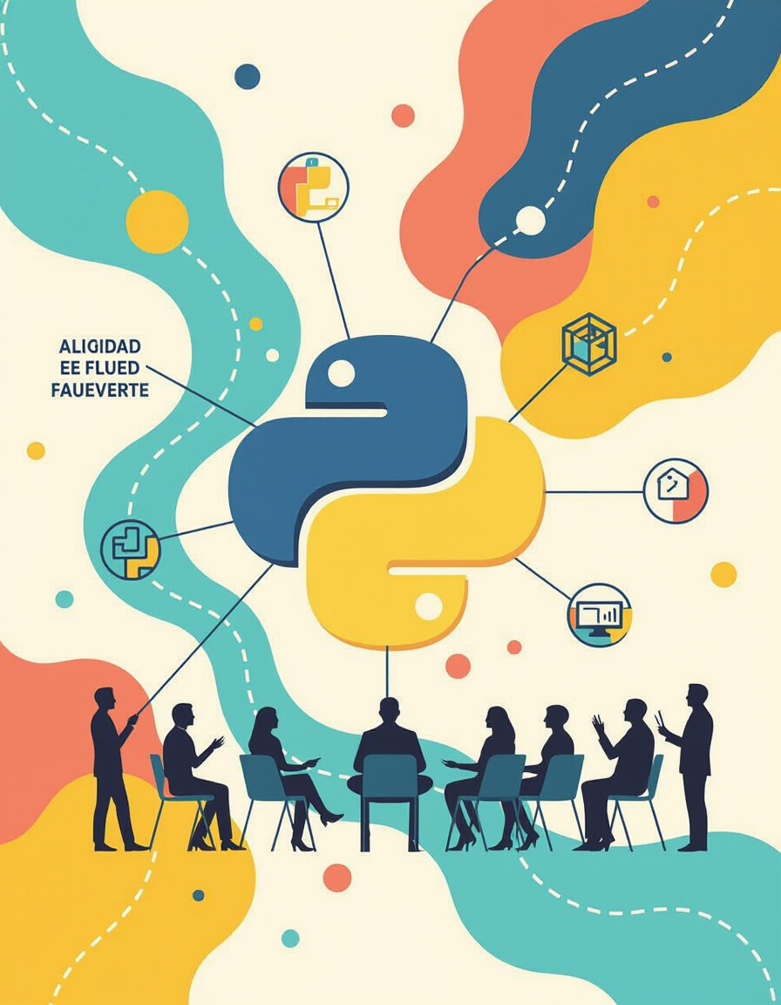
What is Python
Created by Guido van Rossum and first released in 1991.
Core philosophy emphasizes code readability and a clean syntax.
Open-source nature fosters community development and collaboration.

Slide 4
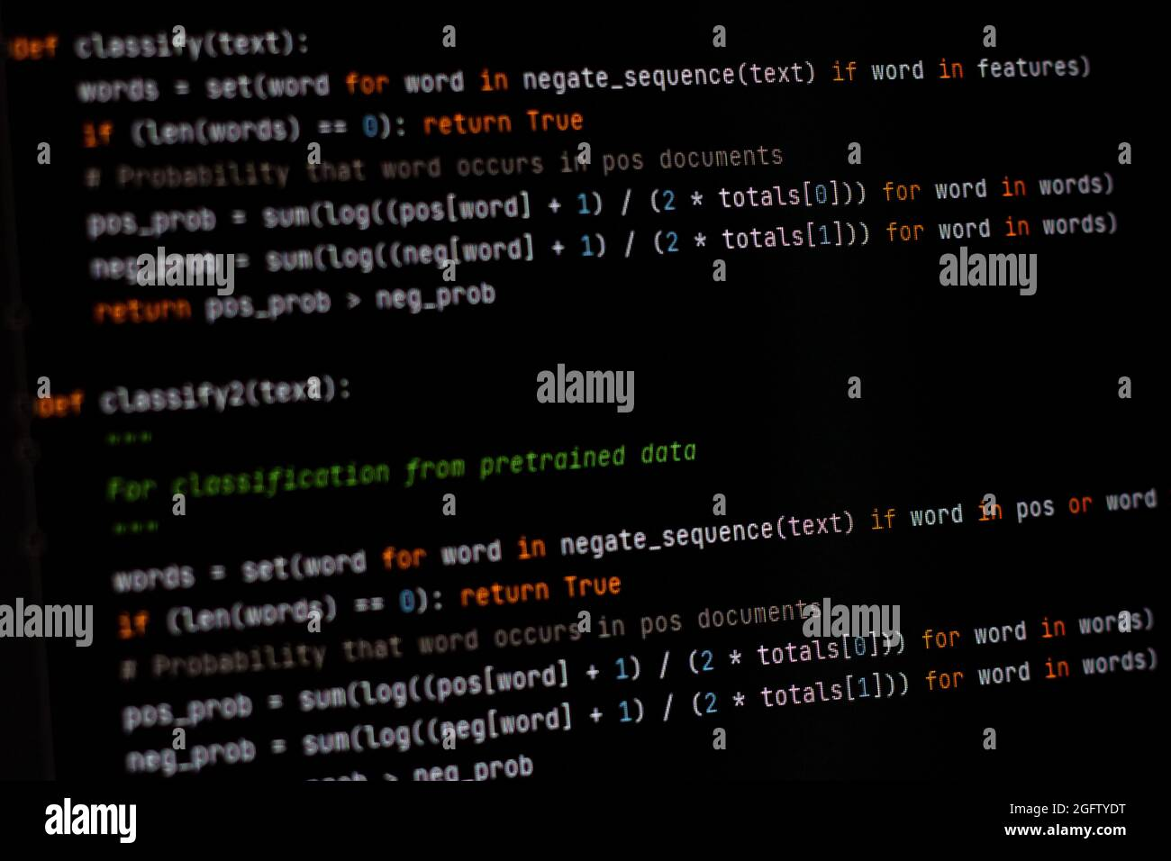
Use Cases of Python
Python's versatility makes it ideal for:
Web Development: Building web applications and APIs.
Data Analysis: Analyzing and visualizing large datasets.
Artificial Intelligence: Developing machine learning models.
Automation: Automating repetitive tasks.
Scientific Computing: Performing complex calculations.

Slide 5
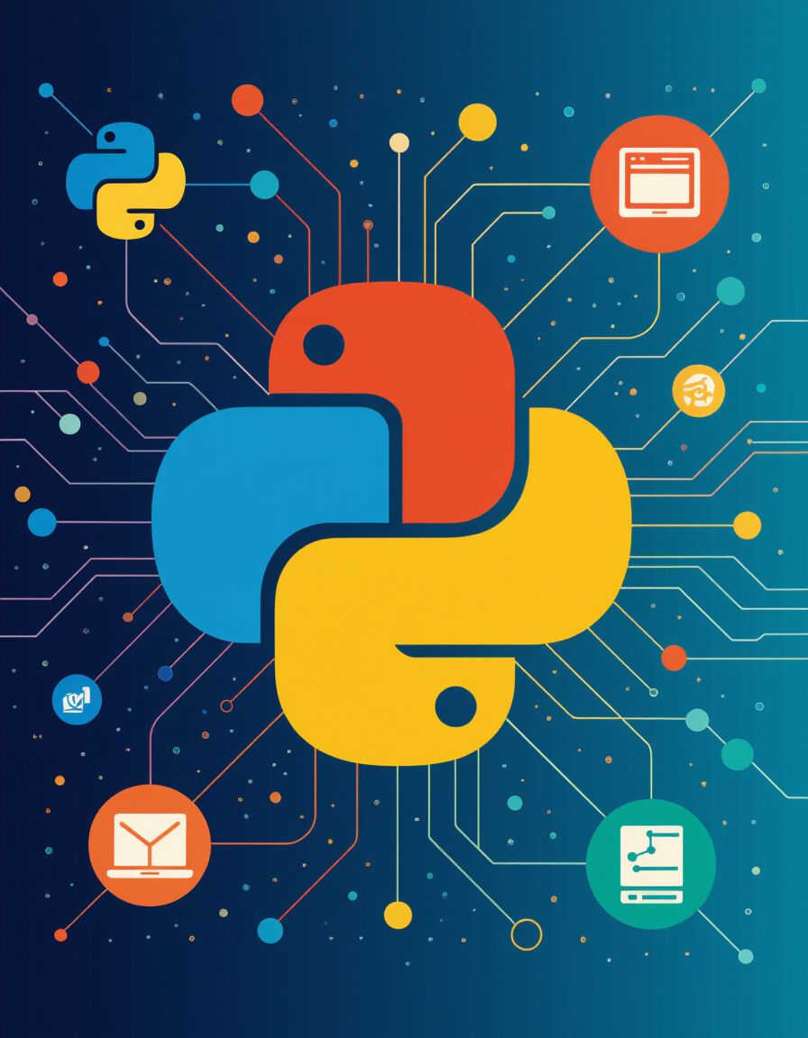
Interesting Facts About Python
Versatile: Used in diverse fields, from web dev to scientific research.
Large Supportive Community: Extensive online resources and libraries.
Beginner-Friendly: Often the first language taught to beginners due to its easy-to-understand syntax.

Slide 6
Understanding Python Packages
Python packages are collections of modules that extend Python’s functionality.
Pre-built code that performs specific tasks.
Easily installable via pip (Python Package Installer).
Save time and effort by leveraging existing solutions.

Slide 7
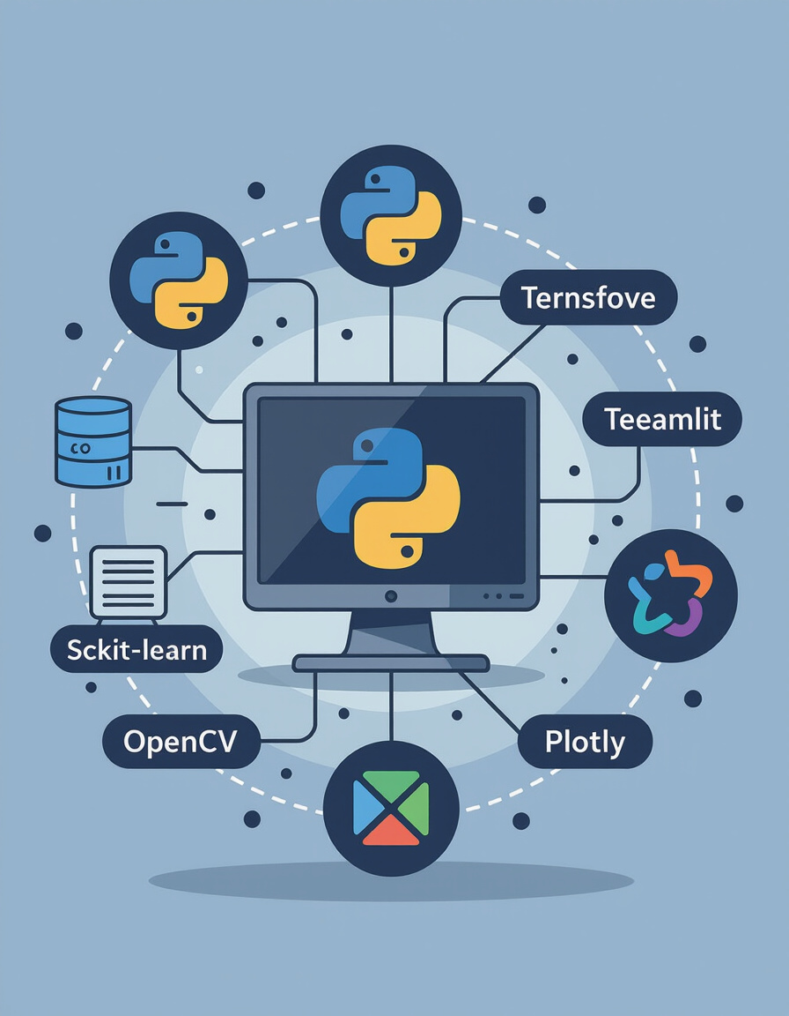
Python Packages Cheat Sheet
Data Analysis: - Pandas, NumPy
Web Development: - Flask, Django, FastAPI
Machine Learning: - Scikit-learn, TensorFlow, PyTorch
API Prototyping: - Flask, FastAPI
Automation Testing: - Selenium, Playwright

Slide 8
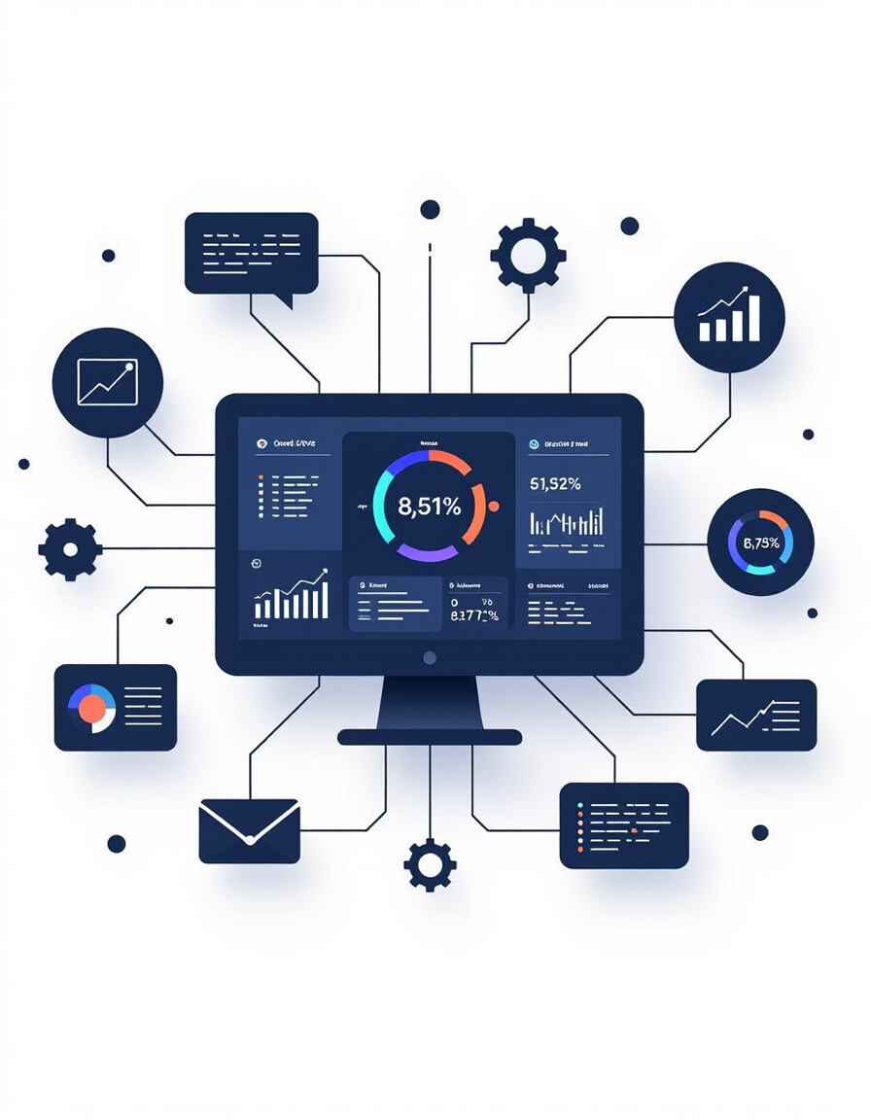
Demo 1: Log Analysis Dashboard
Monitor application logs to identify issues and trends.
Packages Required:
  Pandas: For data manipulation and analysis.
  Matplotlib: For creating visualizations.
  Flask: For building the web framework.

Slide 9

Interactive Quiz 1: Log Analysis Knowledge Check
What package is used for data manipulation in Python?
Name a Python package used for creating graphs and charts.
What framework can build web apps to display log analytics?

Slide 10

Demo 2: Automated API Mocking
Simulate API behavior to test applications without a live server.
Packages Required:
  FastAPI: For creating mock endpoints.
  Requests: For testing API calls.

Slide 11

Interactive Quiz 2: API Mocking Insights
Which library helps in creating mock endpoints quickly?
What does API mocking help achieve during development?
Name a testing library for API calls.

Slide 12
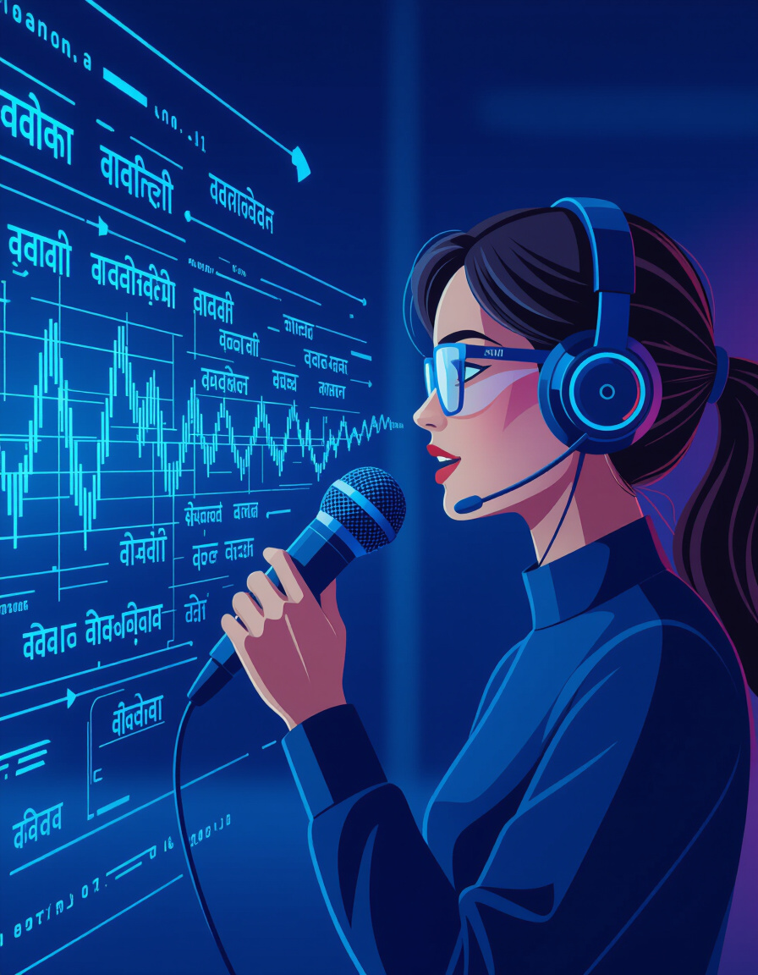
Demo 3: Local Speech to Text Assistant
Convert spoken language into written text locally.
Packages Required:
  SpeechRecognition: For recognizing speech.
  PyAudio: For capturing audio input.

Slide 13

Interactive Quiz 3: Speech Recognition Concepts
Which package helps with capturing live audio for speech recognition?
What is the main role of SpeechRecognition library?
What are some of the pre-trained speech models.

Slide 14
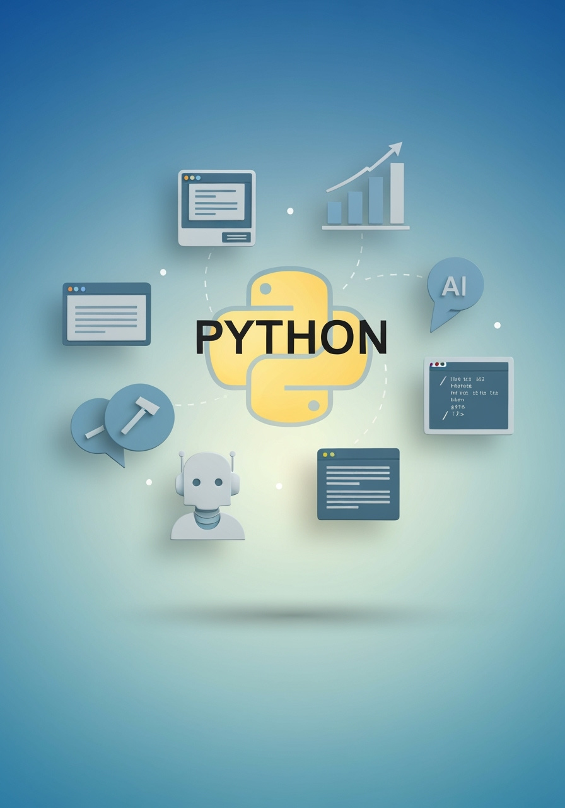
Conclusion and Next Steps
Workshop Highlights:
Python’s simplicity and versatility.
Key Python packages for various applications.
Practical demos with log analysis, API mocking, and speech-to-text.
Next Steps:
Explore Python documentation and online tutorials.
Practice building your own projects.
Join Python communities and forums for support.

